Slide 1

Project Title - AI-Based Network Intrusion Detection System
Mridul Singh Rajput
AICTE ID : STU678e66571705b1737385559

Slide 2

PROBLEM STATEMENT
The Signature Gap: Traditional firewalls cannot stop "Zero-Day" attacks because they don't have a pre-existing rule for them.
Complexity: Modern network traffic (e.g., CIC-IDS2017 dataset) contains millions of packets; humans cannot analyze them manually.
The "Black Box" Issue: Traditional AI tells you "This is an attack," but junior analysts often don't understand the technical reasons behind the alert.

Slide 3
Project Description
1. Project Objective
To develop an intelligent Network Intrusion Detection System (NIDS) that identifies malicious traffic (specifically DDoS attacks) using behavioral analysis rather than static rules.
2. Core Technical Framework
Data Source: Utilizes the CIC-IDS2017 dataset, focusing on 8 key network features (Flow Duration, Packet Length, IAT, etc.).
ML Engine: Implements a Random Forest Classifier for high-speed, accurate classification of traffic into "BENIGN" or "ATTACK."
Platform: A real-time Streamlit Dashboard that simulates live packet capture and analysis.
3. Key Innovation: Explainable AI (XAI)
Integrates Groq (Llama-3) to solve the "Black Box" problem. The system doesn't just flag a threat; it generates a natural language explanation of the technical headers, acting as a virtual Security Analyst for the user.
4. Outcome
Achieves [Insert Accuracy, e.g., 99%+] accuracy while reducing the technical barrier for junior analysts to understand and respond to network threats.

Slide 4

WHO ARE THE END USERS?
Junior Security Analysts (SOC Level 1)
Benefit: Uses the AI Analyst (Groq) to understand complex packet headers without needing years of experience.
Impact: Simplifies decision-making and speeds up the investigation of flagged alerts.
Network Administrators
Benefit: Gains real-time visibility into network health via the Streamlit Dashboard.
Impact: Can quickly identify if a sudden spike in traffic is a legitimate user surge or a DDoS attack requiring immediate mitigation.
Cybersecurity Students & Researchers
Benefit: Uses the "Simulate Random Packet" feature to study the behavior of different attack types in a controlled environment.
Impact: Provides a practical, hands-on tool for learning Machine Learning applications in digital security.
Small to Medium Enterprises (SMEs)
Benefit: Offers a low-cost, AI-driven alternative to expensive, enterprise-grade proprietary security suites.
Impact: Enhances the security posture of organizations with limited specialized cybersecurity staff.

Slide 5

Technology Used
Programming & Backend:
Python: Core language for data processing and model logic.
Pandas & NumPy: For data cleaning and manipulation of the CIC-IDS2017 dataset.
Machine Learning (The Brain):
Scikit-Learn: Used to implement the Random Forest Classifier for high-speed attack detection.
Random Forest: Chosen for its ability to handle complex network traffic features with high accuracy.
Generative AI (The Analyst):
Groq API: Ultra-fast inference engine to run Llama-3.3-70B.
LLM Integration: Translates technical packet headers into plain English for the user.
Frontend & UI:
Streamlit: Framework used to build the interactive web dashboard and real-time simulation interface.

Slide 6
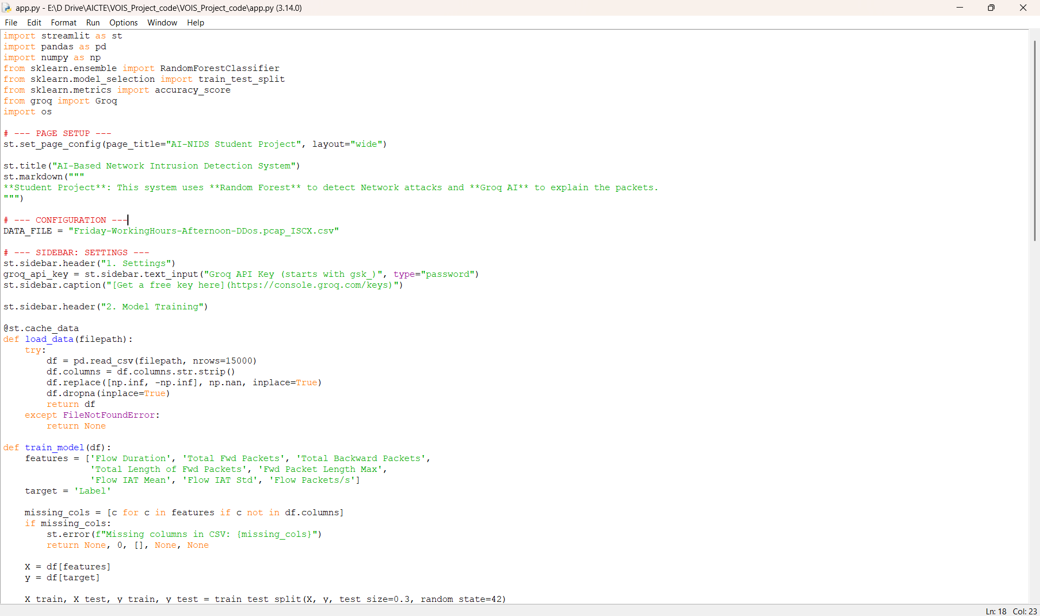
RESULTS
[Add screen shots of your code ]
Demo Link

Slide 7
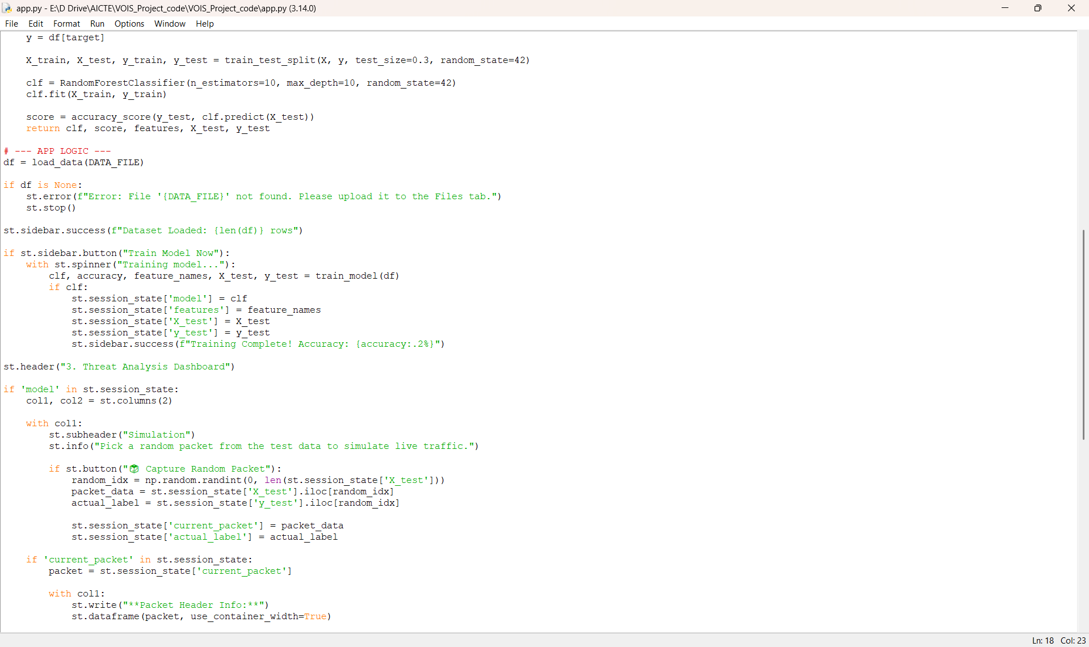
RESULTS
[Add screen shots of your code ]
Demo Link

Slide 8
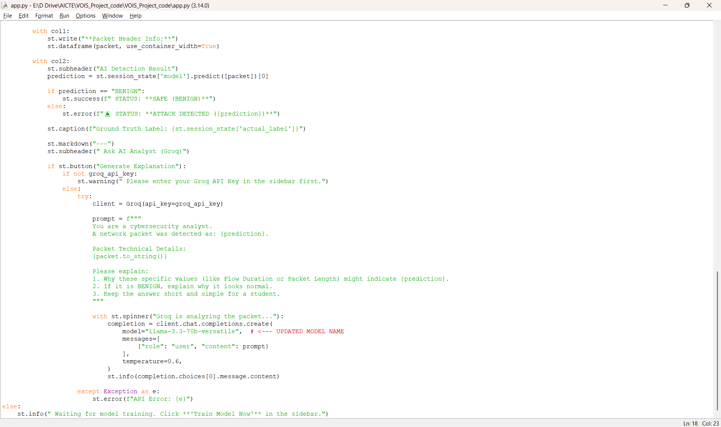
RESULTS
[Add screen shots of your code ]
Demo Link

Slide 9
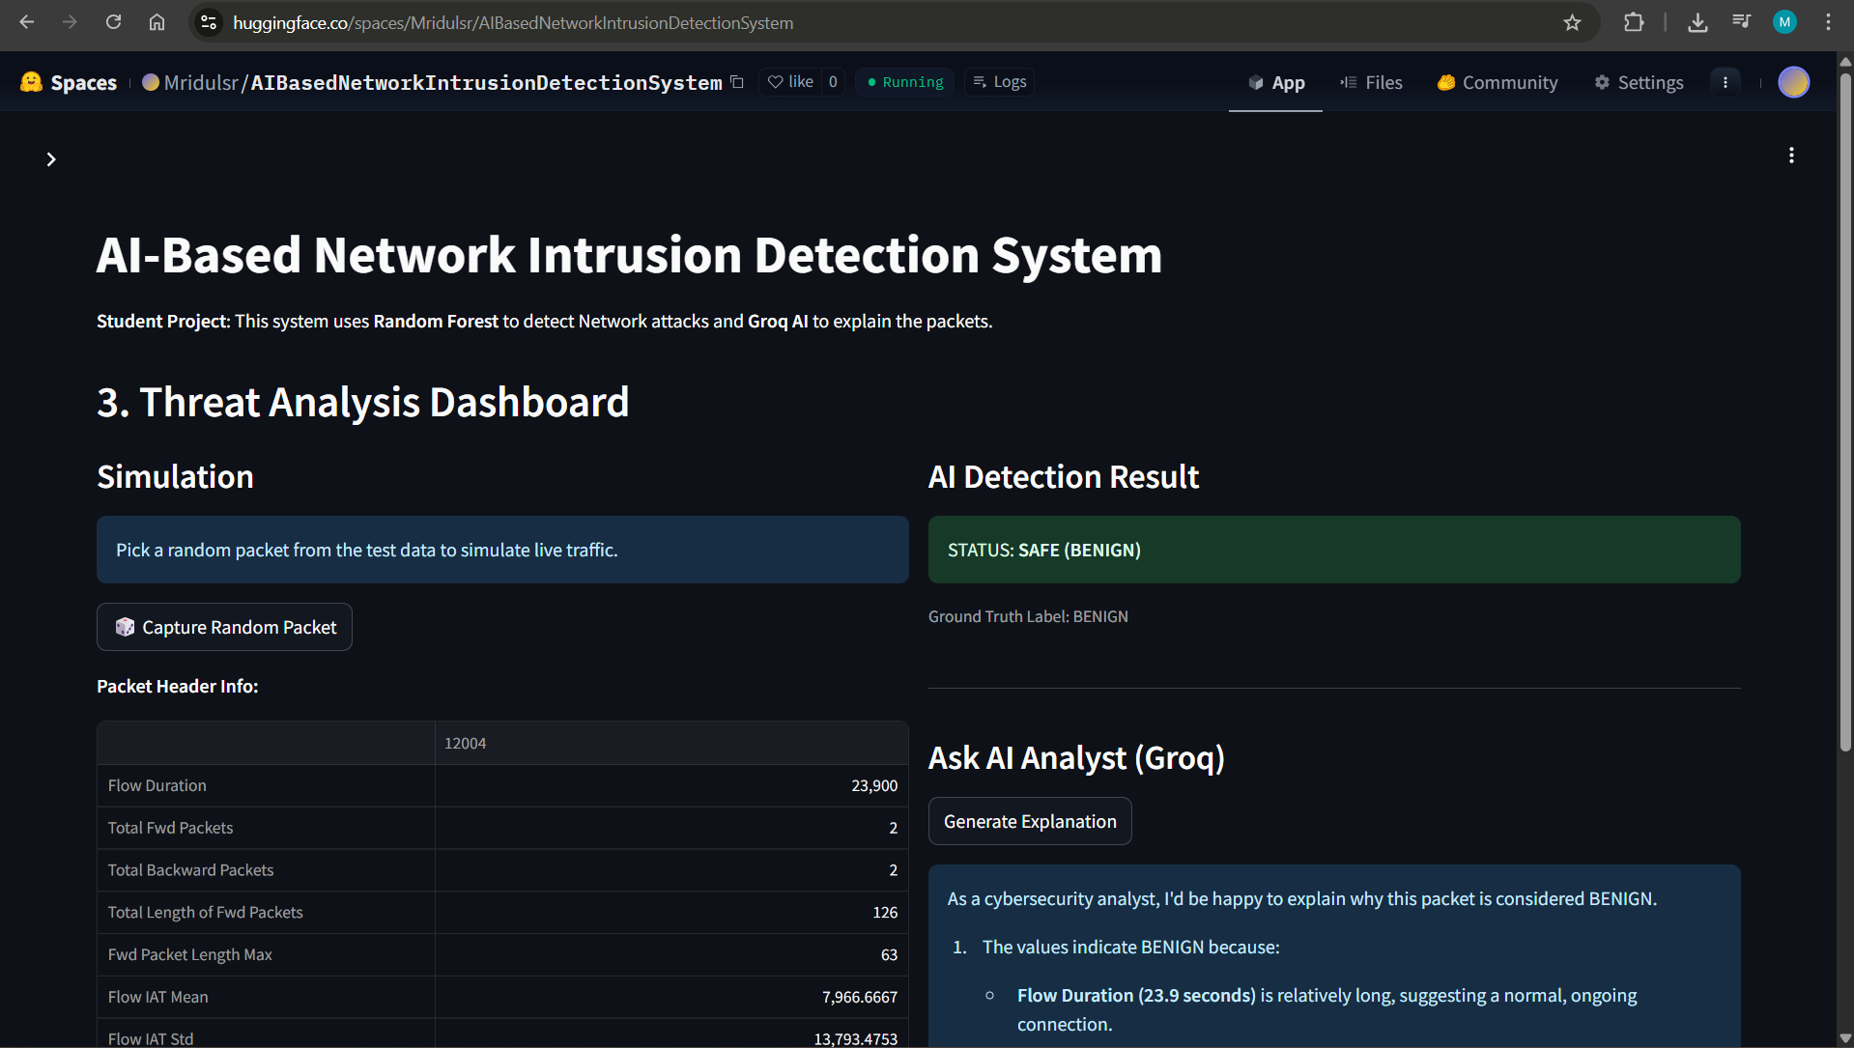
RESULTS
[Add screen shots of your code ]
Demo Link

Slide 10
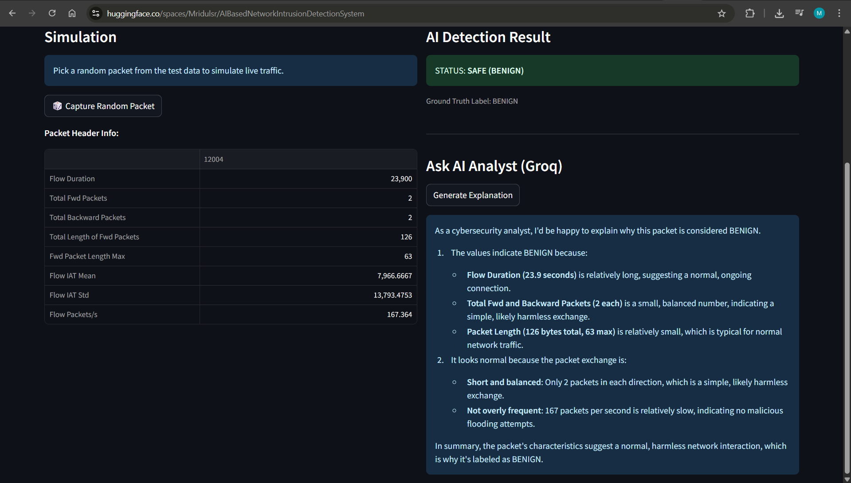
RESULTS
[Add screen shots of your code ]
Demo Link

Slide 11
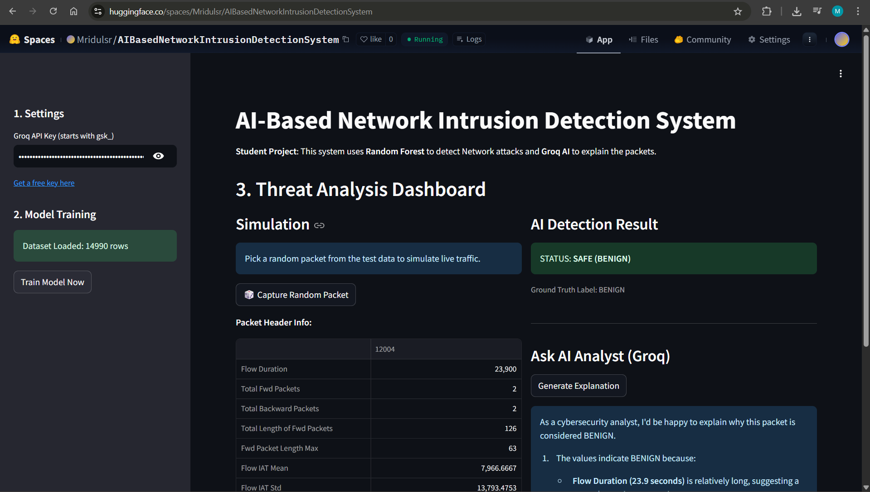
RESULTS
[Add screen shots of your code ]
https://huggingface.co/spaces/Mridulsr/AIBasedNetworkIntrusionDetectionSystem

Slide 12

Certificate - Protection from browser attacks

Slide 13

Certificate - Introduction to System Security

Slide 14

Certificate - Securing Android Devices

Slide 15
GitHub link
https://github.com/Mridulsr/AI-Based-Network-Intrusion-Detection-System

Slide 16
Thank you
.
.

